Slide 1
Communications
& Media
How to Use Google Images

Slide 2
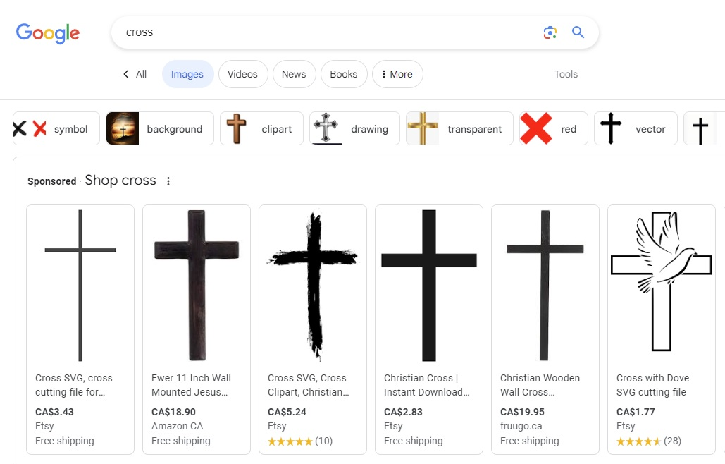
How to Use Google Images
Visit images.google.com.

Slide 3
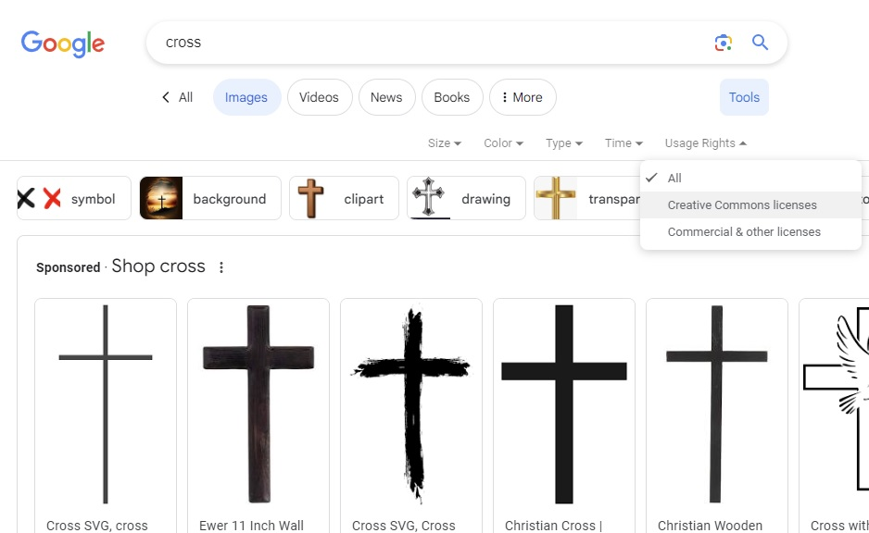
How to Use Google Images
Select Tools, Usage Rights, and Creative Common licenses.

Slide 4
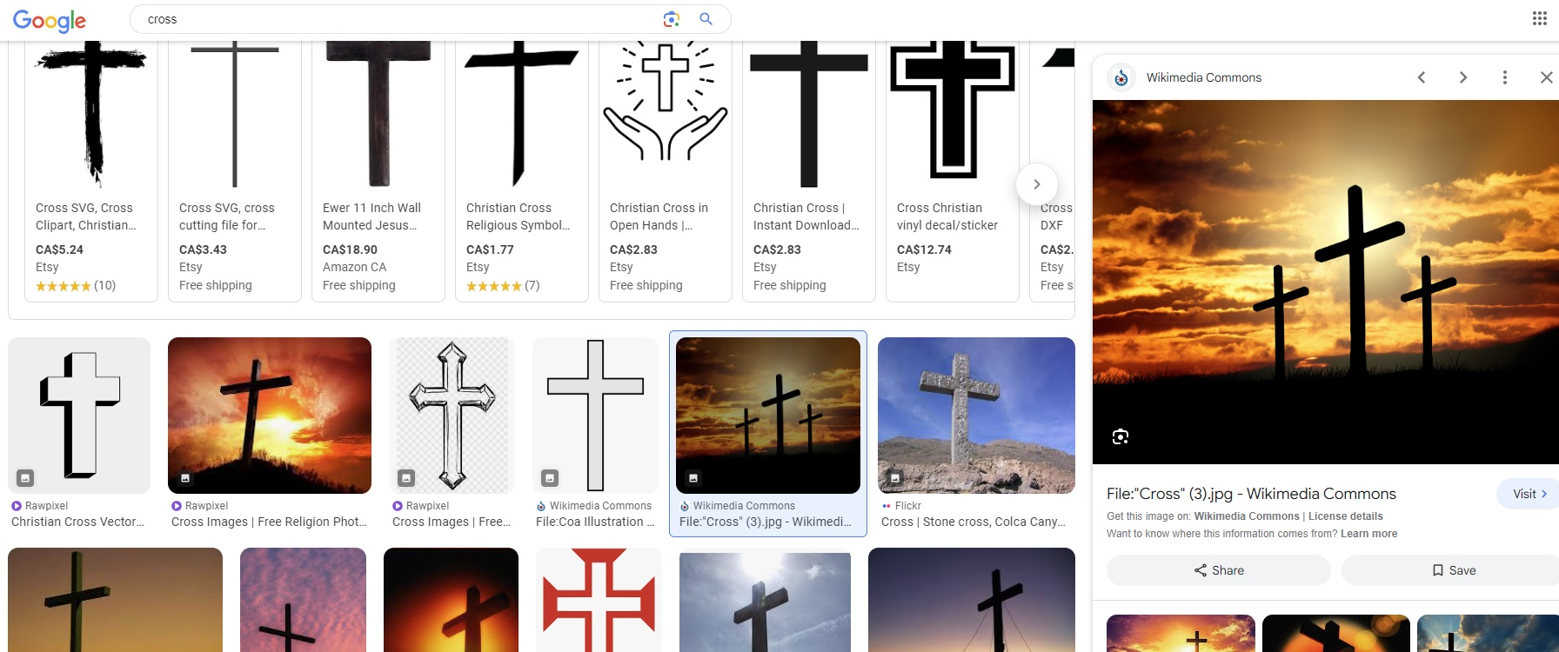
How to Use Google Images
Select a photo, then License details.
Instructions on how the photo can be used will be at this link.
1
2

