Slide 1
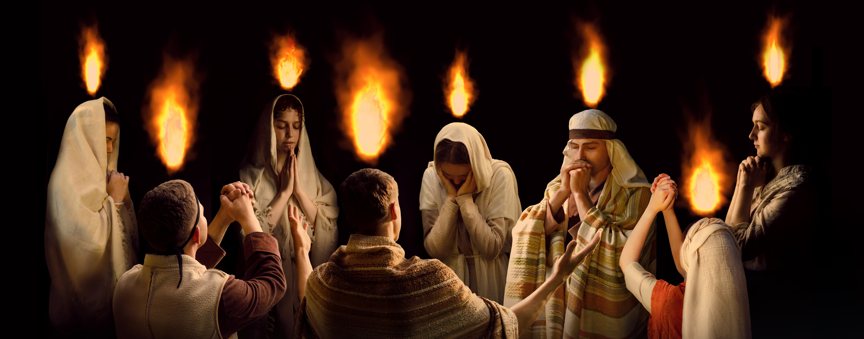
Mission Emphasis
Pentecost & Beyond
Disciples on Fire
On Fire for the Lord Jesus

Slide 2
The Portable Altar
Living Day By Day, Moment By Moment In The Abiding Presence Of God
Allan R. Chichester
Director of Family and Men Ministries
Ontario Conference of the Seventh-day Adventist Church, March 14, 2026

Slide 3
The Portable Altar
God is calling His people not just to have moments of worship, but to live a life that worships anywhere and everywhere.
There is nothing more important for end-time believers than learning to build a portable altar.

Slide 4
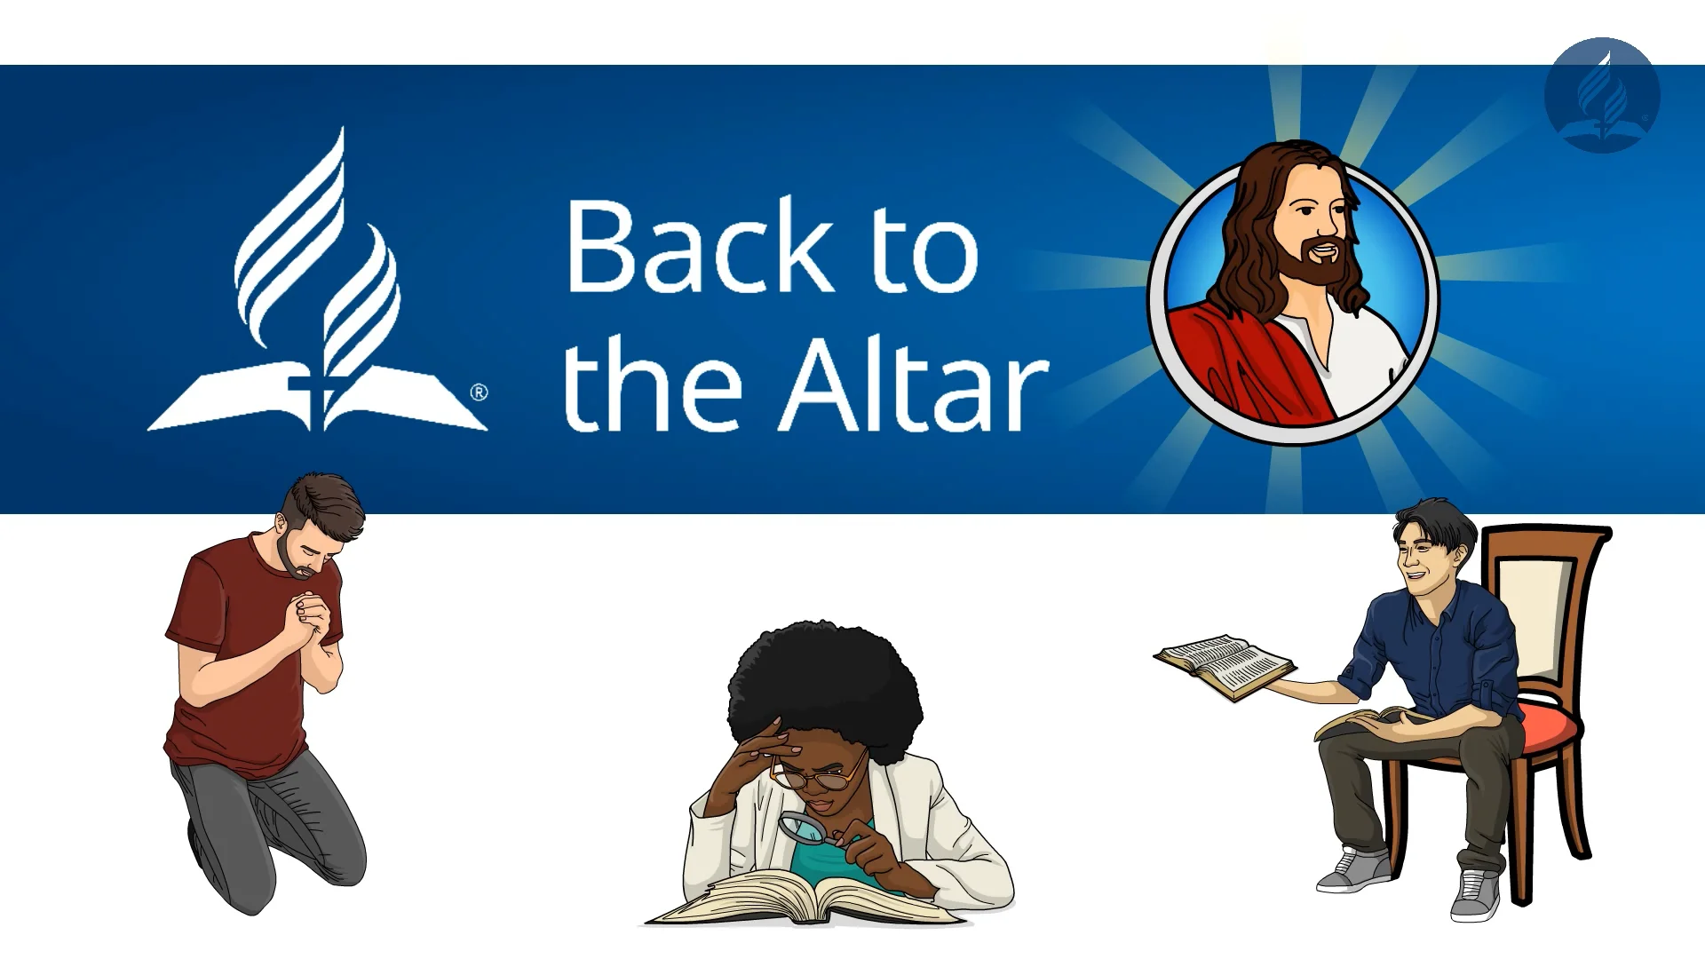

Slide 5
What is “Back to the Altar?”
A global Seventh-day Adventist initiative launched by the General Conference to rebuild personal and family altars of daily worship.
The call: “A daily place for God in every heart and every home.”
The goal: To reignite consistent personal devotion, prayer, and the Word- the fuel of effective discipleship.
Endorsed and implemented across the Ontario Conference since 2023.

Slide 6
Worship in The Book of Genesis
Began in Eden
Moved outside the gates of the Garden of Eden
Story of Cain and Abel
Story of Seth- Genesis 4: 25-26 KJV

Slide 7
Worship Before the Fall
The first full day of existence for Adam and Eve was the Sabbath. Genesis 2:1-3
A day of worship and fellowship
“The Sabbath was instituted in Eden before the fall and was observed by Adam and Eve, and all the heavenly host. God rested on the seventh day and blessed and hallowed it.” Ellen G. White, Early Writings, p.217
Job 38:4-7 speaks of worship during the creation week
Psalm 104:1-4

Slide 8
The Fall Impacted Worship
“At the cherubim-guarded gate of paradise, the glory of God was revealed, and hither came the first worshipers. Here their altars were reared, and their offerings presented. It was here that Cain and Abel had brought their sacrifices, and God had condescended to communicate with them.”
White, Ellen G. Patriarchs and Prophets pp. 83-84

Slide 9
What Does “The Altar” Mean?
In the Bible, the altar is one of the most important spiritual symbols.
The altar was the place where people met God.
It was a place of:
Worship
Surrender
Sacrifice
Renewal
Communion with God
Whenever someone built an altar, it meant one thing: they wanted to meet with God.

Slide 10
Men Began To Call On The Name of The Lord-Genesis 4:25
Call on
Call on Him in worship - includes surrendering to God.
Proclaim
Proclaim the name of the Lord - includes discipling their children and witnessing for God.
Be
Be called by His name - to be known as people who were loyal to him.
Call on
Call on Him for help - through prayer.

Slide 11
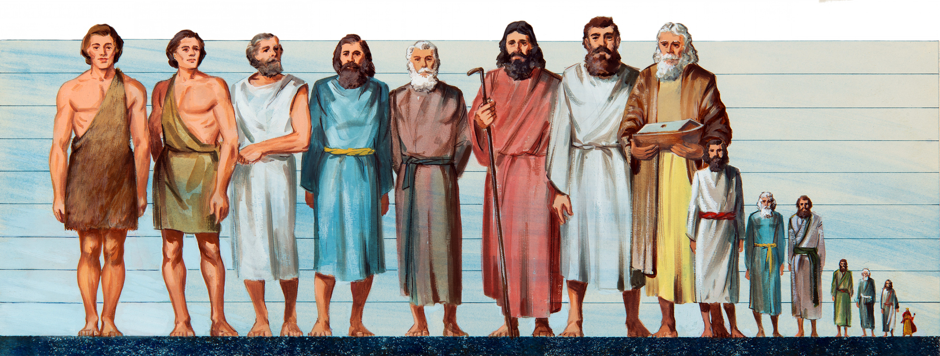
From Generation To Generation
This means worship became central to survival.
From generation to generation, people who stayed close to God built altars.

Slide 12
What Is Worship?
The English word worship comes from an Anglo-Saxon word: weorthscipe.
It comes from two parts:
“Worth” and “ship.”
It literally means to declare someone worthy.

Slide 13
What Is Worship?
Revelation 5 describes a powerful moment in heaven.
The angels sing:
“Worthy is the Lamb who was slain.”
And every creature responds with blessing and honor and glory.
That is worship!

Slide 14
What Is Worship?
Worship is encounter.
When you encounter God, something changes inside you.
Worship is also communion.
It is relationship.

Slide 15
To worship is:
“to quicken the conscience by the holiness of God
to feed the mind with the truth of God
to purge the imagination by the beauty of God
to open the heart to the love of God
to devote the will to the purpose of God”
Segler and Bradley, Christian Worship: It Theology and Practice

Slide 16

True Worship
True worship always leads to transformation.
You cannot encounter the living God and remain the same person.

Slide 17
Enoch and The Portable Altar
May have been one of the first early disciples to understand that the altar is portable.
“The infinite, unfathomable love of God through Christ became the subject of his meditations, day and night; and with all the fervour of his soul, he sought to reveal that love to the people among whom he dwelt. Enoch’s walk with God was not in a trance or vision, but in all the duties of his daily life.” White, Ellen G. Patriarchs and Prophets pp. 84-85

Slide 18
Enoch and The Portable Altar
“Enoch was a man of a strong and highly cultivated mind and extensive knowledge; he was honored with special revelations from God; yet, being in constant communion with heaven, with a sense of the divine greatness and perfection ever before him, he was one of the humblest of men. The closer the connection with God, the deeper was the sense of his own weakness and imperfection.”
White, Ellen G. Patriarchs and Prophets p. 85

Slide 19
Abraham and the Portable Altar Genesis 12
When Abraham entered the promised land, the Lord appeared to him.
And what did Abraham do? He built an altar.
Then he travelled to another place. And he built another altar.
Then he moved again. And he built another altar.
Everywhere Abraham went, he built an altar.
Ellen White describes it this way:
“The life of Abraham, the friend of God, was a life of prayer. Wherever he pitched his tent, close beside it was built an altar.”
My Life Today, p.35

Slide 20
Abraham And The Portable Altar
Notice the order:
First the tent
Then the altar
Wherever he lived, the altar was central.
It showed that Abraham’s life revolved around communion with God.
That is what made him the friend of God.

Slide 21
Jacob, The Portable Altar
“Surely the Lord is in this place, and I did not know it.”
Notice that:
God was already there
Jacob simply became aware of His presence
This is one of the secrets of the portable altar
God is present in more places than we realize
We simply need to become aware of Him.

Slide 22
What Did Jacob Do?
“And Jacob rose up early in the morning and took the stone that he had put for his pillows, and set it up for a pillar, and poured oil upon the top of it. In accordance with the custom of commemorating important events, Jacob set up a memorial of God’s mercy, that whenever he should pass that way, he might tarry at this sacred spot to worship the Lord.”
White, Ellen G. Patriarchs and Prophets, p. 187

Slide 23
Jesus and the Abiding Life
Jesus called His disciples with two simple words:
“Follow Me.”
To follow Jesus means to walk with Him.
To stay close to Him.
Later, in John 15, Jesus gives another powerful teaching.
He says:
“Abide in Me.”
The Greek word used for abide means:
stay connected
continue dwelling
Remain

Slide 24
Jesus was describing a continuous relationship
Not occasional visits
Not weekly meetings
But a daily connection!

Slide 25
Guess What
Enoch understood this concept of the portable altar - He walked with God daily.
Paul understood this concept - He saw our bodies as the temple of God and a dwelling place of the Holy Spirit.
Ephesians 5:18 (KJV) says: “Be filled with the Holy Spirit.”

Slide 26
How Do We Become God-Walkers?
How do we actually live this kind of life?
How do we build a portable altar?
How do we live day by day in the abiding presence of God?

Slide 27
1. Know Where You Are Spiritually
The first step is honesty.
You need to know where you are in your spiritual journey.
Ask yourself:
Am I growing spiritually?
Am I stagnant?
Am I drifting?
Awareness is the first step toward transformation.

Slide 28
2. Come to Jesus As You Are
Jesus says in Matthew 11:28 (KJV)
“Come unto me, all ye that labour and are heavy laden, and I will give you rest.”
He came to His own, and His own did not receive Him. 12 But to all who did receive Him, to those who believed in His name, He gave the right to become children of God John 1:11-12 Berean Standard Bible

Slide 29
3. Surrender To Jesus Daily
Every morning, we must surrender our lives to God again.
“Consecrate yourself to God in the morning; make this your very first work. Let your prayer be, “Take me, O Lord, as wholly Thine. I lay all my plans at Thy feet. Use me today in Thy service. Abide with me and let all my work be wrought in Thee.” This is a daily matter. Each morning consecrate yourself to God for that day. Surrender all your plans to Him, to be carried out or given up as His providence shall indicate. Thus, day by day you may be giving your life into the hands of God, and thus your life will be molded more and more after the life of Christ.”
Ellen White, Steps To Christ, pp. 70, 71

Slide 30
Why Is This Important ?
It reminds us of who we are and whose we are:
Sons and daughters of the King
We belong to Jesus
Thus, we are assured that we can face the day because we have had an audience with the King.

Slide 31
Why should We Do This?
“Nothing is more needed in our work than the practical results of communion with God. We should show by our daily lives that we have peace and rest in the Saviour. His peace in the heart will shine forth in the countenance .... Communion with God will ennoble the character and the life. Men will take knowledge of us, as of the first disciples, that we have been with Jesus. This will impart to the worker a power that nothing else can give. Of this power, he must not allow himself to be deprived.”

Slide 32
Why should We Do This?
We must live a two-fold life … a life of thought and action, of silent prayer and earnest work.” The Ministry of Healing p. 512
“All who are under the training of God need the quiet hour for communion with their own hearts, with nature, and with God .... We must individually hear Him speaking to the heart. When every other voice is hushed, and in quietness we wait before Him, the silence of the soul makes more distinct the voice of God. He bids us, “Be still, and know that I am God.” Psalm 46:10. This is the effectual preparation for all labour for God.

Slide 33
Why should We Do This?
“Amidst the hurrying throng and the strain of life’s intense activities, he who is thus refreshed will be surrounded with an atmosphere of light and peace. He will receive a new endowment of both physical and mental strength. His life will breathe out a fragrance and will reveal a divine power that will reach men’s hearts.”
Ellen G. White, The Ministry of Healing, p. 58

Slide 34
4. Honor Jesus as Lord Daily
Living with a portable altar affects our daily choices. It affects:
What we watch
What we think about
How we treat people
Job once said, “I made a covenant with my eyes not to look lustfully at a young woman.” Job 31:1
Holiness often begins with small daily decisions. Every decision is an opportunity to honour Christ.

Slide 35
5. Discover Jesus In His Word And Through Prayer
Luke 24:27 tells us that Jesus explained the Scriptures to the disciples.
And beginning at Moses and all the prophets, he expounded unto them in all the scriptures the things concerning Himself.
This means the Bible is ultimately about Jesus.
When you read the Bible, ask:
What does this passage reveal about Christ?

Slide 36
Prayer: An Audience With the King
Set aside time daily for prayer
King David - “Evening, and morning, and at noon, will I pray, and cry aloud: and he shall hear my voice.” Psalm 55:17
Daniel - “Daniel always prayed to God three times every day. Three times every day, he bowed down on his knees to pray and praise God.” Daniel 6:10 KJV

Slide 37
Martin Luther And Prayer
Martin Luther once said:
“I have so much to do that I shall spend the first three hours in prayer.”
He understood something important.
Prayer is not wasting time.
Prayer is investing in the most important relationship in the universe.

Slide 38
6.Receive A Fresh Baptism Of The Holy Spirit
“And be not drunk with wine, wherein is excess; but be filled with the Spirit.” Ephesians 5:18

Slide 39

Acts 1:8
“And you shall receive power when the Holy Spirit has come upon you; and you shall be witnesses to Me in Jerusalem, and in all Judea and Samaria, and to the end of the earth.”

Slide 40
7. Protect the Quiet Hour From Digital Distractions
We live in a world where our attention is constantly under attack.
Our phones vibrate. Notifications pop up. Social media feeds never end.
And many people wake up in the morning and the first voice they hear is not God’s voice—it is their phone.
If we want to build a portable altar, we must learn something called digital hygiene.

Slide 41
Practice Digital Hygiene
Dwain Esmond describes something very important called digital hygiene. Just like we practice physical hygiene, brushing our teeth, and washing our hands, we must practice digital hygiene with our devices. Digital hygiene simply means developing healthy habits with technology, so it does not control our lives. One of the key principles he emphasizes is this:
Technology should be a servant, not a master.

Slide 42
How To Practice Digital Hygiene
Do not check your phone first thing in the morning. Our first conversation should be with God. When we start the day with notifications, news, and messages, our minds become distracted and anxious instead of being centered on God. Instead, build the altar before you touch the phone.
Turn off non-essential notifications. Every “ping” could be designed to pull your attention away from what matters. Silence the distractions so you can hear God’s voice more clearly.
Schedule screen-free time.
Just like we schedule meetings, we should schedule time away from screens. That time becomes sacred space for: prayer, reflection, family connection, and reading Scripture.

Slide 43
5. Love Your Family Sacrificially
Malachi 4:5,6 (KJV)
Recognize God’s presence in your home - Noah
Speak words that build people up.
Forgive quickly.
Remove bitterness.
Romans 13:8 (KJV) says,
“Owe no one anything except love.”

Slide 44
Love Is The principle of Action
“The loveliness of the character of Christ will be seen in His followers. It was His delight to do the will of God. Love to God, zeal for His glory, was the controlling power in our Saviour’s life. Love beautified and ennobled all His actions. Love is of God. The unconsecrated heart cannot originate or produce it. It is found only in the heart where Jesus reigns. We love, because He first loved us. In the heart renewed by divine grace, love is the principle of action. It modifies the character, governs the impulses, controls the passions, subdues enmity, and ennobles the affections. This love, cherished in the soul, sweetens the life and sheds a refining influence on all around.”
Ellen White, Steps To Christ, p.84

Slide 45
8. Disciple Others
Jesus calls us to follow Him in making disciples.
The Greek of Matthew 28:19 could be translated, “As you are going, make disciples.”
Think about:
your friends
your coworkers
your neighbours
your family members
Write down their names.
Pray for them.
Ask God to open doors for spiritual conversations.

Slide 46
Disciple Others Like Enoch
“Enoch became a preacher of righteousness, making known to the people what God had revealed to him. Those who feared the Lord sought out this holy man to share his instruction and his prayers. He labored publicly also, bearing God’s messages to all who would hear the words of warning…In the midst of a life of active labor, Enoch steadfastly maintained his communion with God. The greater and more pressing his labors, the more constant and earnest were his prayers.”
White Ellen, G. Patriarchs and Prophets p. 86

Slide 47
9.Live Your Mission
Every believer has a mission. Not just pastors, not just evangelists, everyone. God has placed you where you are for a reason. Your workplace, your school, your neighborhood, your arena of influence, those places are your mission field.

Slide 48
Every True Disciple Is A Missionary
“Every true disciple is born into the kingdom of God as a missionary. He who drinks of the living water becomes a fountain of life. The receiver becomes a giver. The grace of Christ in the soul is like a spring in the desert, welling up to refresh all, and making those who are ready to perish eager to drink of the water of life.”
White, Ellen G. The Desire of Ages, p. 184

Slide 49
The Most Powerful Witness
Let me leave you with one question. Do you simply visit God occasionally, or do you walk with Him daily?
God is calling His people to build portable altars, altars that travel with us: in the morning, at work, in the home, in moments of stress in moments of decision. When you carry the altar with you, you carry the presence of God, and a life lived in the presence of God is the most powerful witness the world will ever see.

Slide 50
REFERENCES
https://www.backtothealtar.org/
Esmond, Dwaine. Digital Hygiene for Individuals and Families
MacLafferty, Don. The Way Back to the Altar
White, Ellen G. The Desire of Ages
White, Ellen G. My Life Today
White, Ellen G. Patriarchs and Prophets
White, Ellen G. The Ministry of Healing
White, Ellen G. Steps To Christ

