Slide 1

Biblical Foundations of Men’s Ministries
Does Men’s Ministries really work?

Slide 2

“We seldom realize fully that we are sent to fulfill God-given tasks... We act as if we were simply dropped down in creation and have to decide how to entertain ourselves until we die. But we were sent into the world by God, just as Jesus was. Once we start living our lives with that conviction, we will soon know what we were sent to do.”
Henri J M. Nouwen

Slide 3

Why Men’s
Ministries?
  To bring men to God
  To minister to their specific needs
  To give them purpose
  To help them succeed as Christians
.

Slide 4

Perhaps you came with many questions...

Slide 5

or perhaps you are open to the possibilities,
and wish to see change, progress...

Slide 6

You want to see men in your church sense that
Christian life is the only path
to success

Slide 7

What do men...
  Want?
  Need?
  Like?
  What distracts them from a fulfilled and responsible life with God and their family?

Slide 8

What do men talk about?
What is most important to them?

Slide 9

Some men are
natural leaders but
all men influence
those around them in ways greater than they realize.

Slide 10

Men
  are not easy to change from the outside; a reason for their powerful influence
  their priorities are often directed toward peripheral things in life

Slide 11

The Challenge is
  getting them to adopt God’s priorities
  it will be tough
  but the results will be spectacular and
rewarding

Slide 12

We will start with men as they are,
where
they are
and plot a course that helps them become strong men of God

Slide 13

Your church base
  perfect setting for men to pursue support & instruction
  could be seen as source of problems if it fails to meet their needs

Slide 14
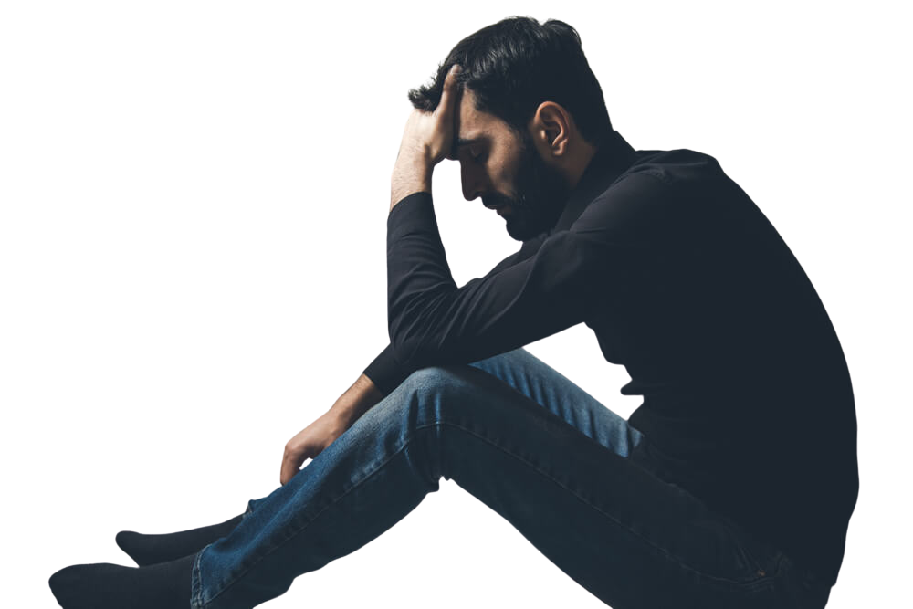
Men’s Ministries
is important
because
  Men are lonely
  Men need to clarify the difference between “toxic masculinity” and Christ-imitating masculinity
  Men need to recalibrate to their ultimate “vocation”: Imago Dei

Slide 15

Men’s Ministries
is important
because
  The nature, character, and role of men is being constantly assaulted in media.
  Men need spiritual mentors, direction and instructions.
  Men need to become aware of their true spiritual condition

Slide 16

Men’s Ministries
is important
because
  Men need to identify their real enemy
  Men need to address their trauma

Slide 17

pushing
coercing
guilt tripping
too much information
won’t help!!

Slide 18

Men Need to Address their Loneliness

Slide 19

Loneliness
  Man was wired to experience optimal physical, emotional and spiritual health through healthy relationships.
  Traditional views of masculinity discourage vulnerability and emotional expression.
  To be “manly” men are taught to stuff their emotions and keep conversations superficial.

Slide 20
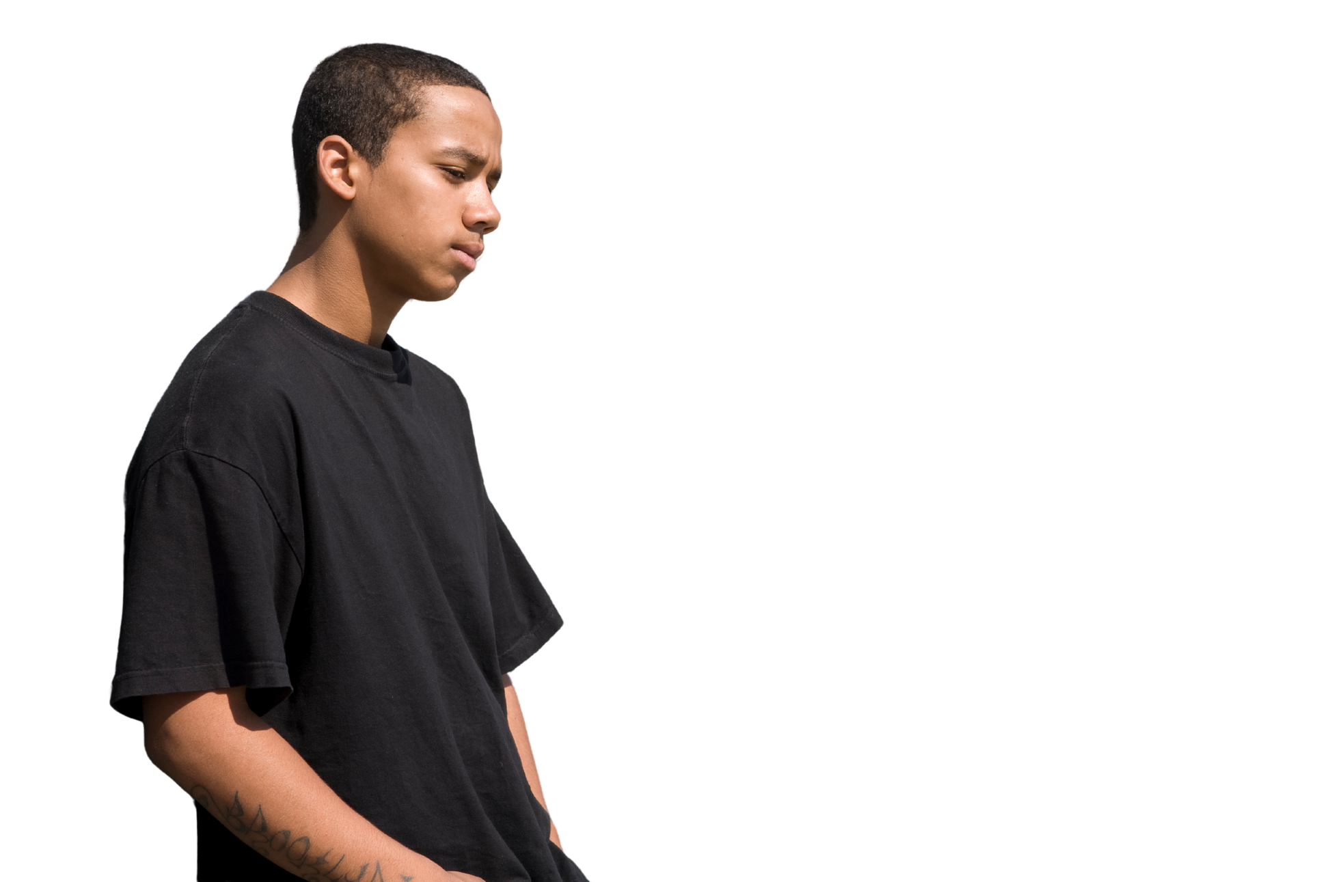
Loneliness Epidemic
  Data on male loneliness is rather staggering in American culture.
A 2019 Cigna survey (pre-Covid) reported:
50%
44%
  men felt lonely
  men age 60 and up feel lonely
  compared to
40%
  women felt lonely
18%
  men ages 18-24 report feeling lonely “often” or “always”
1990 - 2021
  the number of men who stated they had no close friends grew
3%
  to
15%
  www.biblicalcounselingcoaltion.org

Slide 21
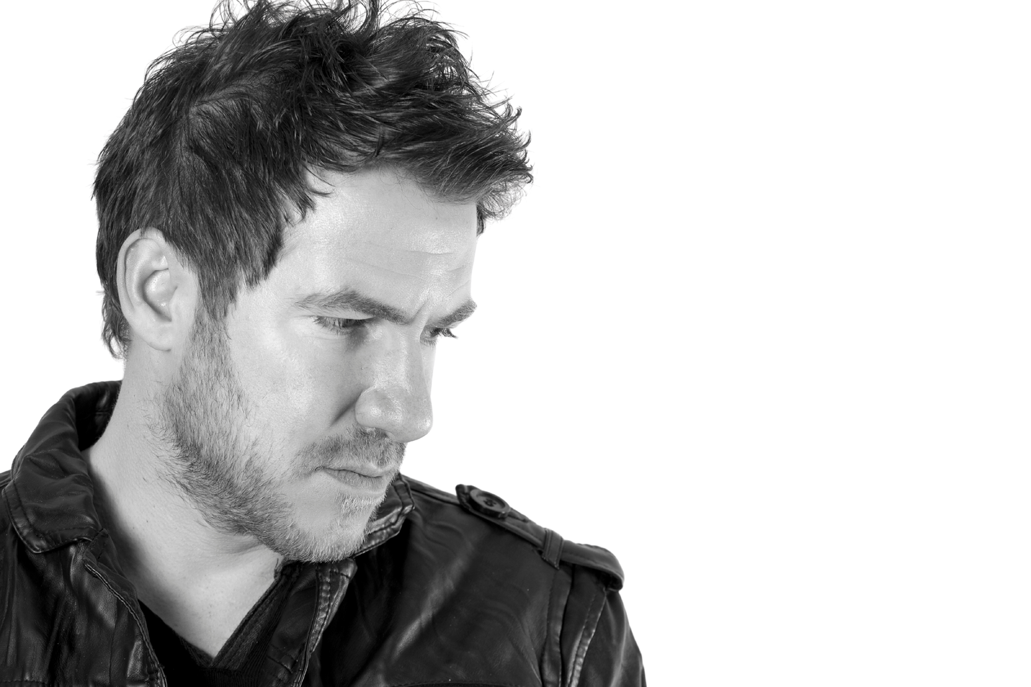
Mental Health Concerns
  Men are less likely than women to seek help.
  Prolonged loneliness leads to mental health concerns such as
depression, anxiety, suicidal thoughts.
25.6%
  women sought mental health treatment
  compared to
14%
  men sought mental health treatment
  Men are
3 - 4
  times more likely to die by suicide

Slide 22

Men Need to Differenciate
Toxic Masculinity from
Masculinity
Christ
Imitating

Slide 23

Toxic Masculinity
  Society increasingly blames its existence on
  “biblical patriarchy.”
  Patriarchy = “rule of the father”
Pater Familias
  Israel in the OT was under patriarchal system. This system was directly connected to God’s directions and principles
  In the church, husbands and fathers are accountable to God.

Slide 24

Toxic Masculinity
  Means different things to different people.
  Generally refers to a collection of offensive and harmful beliefs, tendencies, and behaviors rooted in traditional male roles but taken to an extreme.
  Tends to perpetuate domination, aggression, and can be harmful to the mental health of men and women.

Slide 25

Toxic Masculinity
Key tenants include:
  Emotional suppression - “man up”
  Aggression, dominance and power -glorification of physical & emotional toughness and the power of money.
  Rejection of healthy traits deemed feminine- like compassion, grace, mercy, seeking help, domestic tasks.
  Hyper-independence
  Sexual conquest and objectification
  Heteronormativity - kind men are seen as weak and “too soft”.

Slide 26

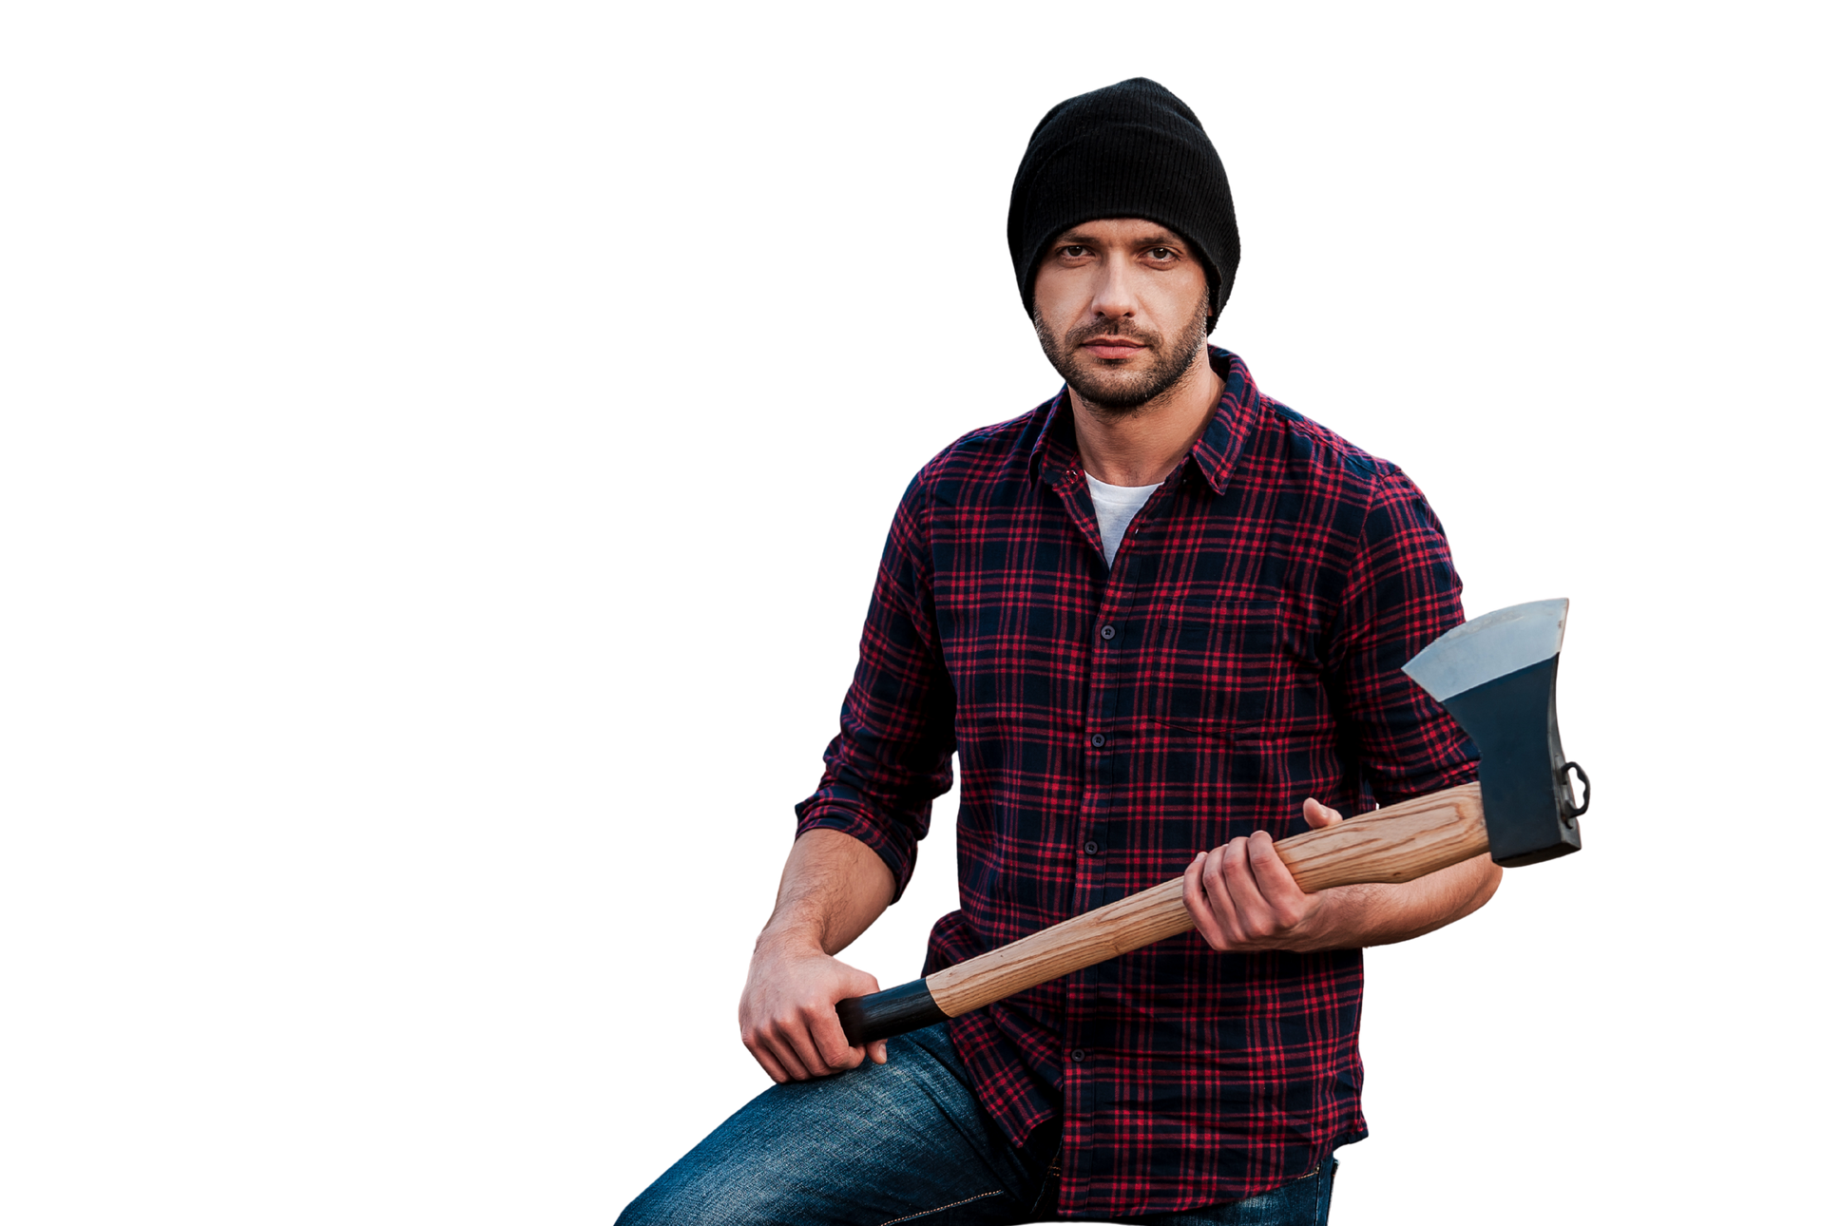
Masculinity--
is not Toxic
Distorted perceptions of manhood began at the Fall and have been passed down generationally and culturally.
Returning to the Word of God clarifies the murky waters.

Slide 27

Men Need to Recalibrate
their Imago Dei

Slide 28

God
The Lord passed in front of Moses, calling out,
“Yahweh! The Lord!
The God of compassion and mercy!
I am slow to anger
and filled with unfailing love & faithfulness
I lavish unfailing love to a thousand generations. I forgive iniquity, rebellion, and sin.
But I do not excuse the guilty.
I lay the sins of the parents upon their children and grandchildren; the entire family is affected--even children in the third & fourth generations.
Exodus 34:6-7

Slide 29

Imago Dei
Men need to recalibrate their ultimate “vocation”: Imago Dei (Image of God)
  Covenant/Commitment - God makes covenant with men; men make commitments to God
  Empowerment - God empowers his fallen children; men empower his wife and others

Slide 30

Role of Men under Assault
by the Media

Slide 31

Media’s Assault on Men
Diminishes regard for
  Commitment
  Gracing
  Empowerment
  True Intimacy

Slide 32

Men Need Spiritual Mentors

Slide 33

Need for Spiritual Mentors... and Instructions
This is God’s design
  Joshua
  Elisha
  Timothy & Titus
  Who has mentored you?

Slide 34

Need for Spiritual Mentors... and Instructions
XXX
  XXX
  XXX
  XXX
  XXX

Slide 35

Men need to identify their real enemy.

Slide 36
The Real Enemy is...
“Why is that Satan meets no greater resistance?
Because the soldeirs of Christ have so little
real connection with Christ.
Sin is not to them repulsive as it was to their Master.
They do not meet it with determined resistance.
They are blinded to the character of the prince of darkness.
Multitudes do not know that their enemy is
a mighty general warring against Christ.
Even ministers of the gospel over look the evidences
of his activity. They seem to ignore his very existence.”
White, the Great Hope c5.6

Slide 37
Be Vigilant...
“Never forget the inspired warning sounding down the centuries to our time: “Be sober, be vigilant; because your adversary the devil, as a roaring lion, walketh about, seeking whom he may devour.” “Put on the whole armour of God, that ye may be able to stand against the wiles of the devil.” 1 Peter 5:8; Ephesians 6:11.
OUR GREAT ENEMY IS PREPARING FOR HIS LAST CAMPAIGN. ALL WHO FOLLOW JESUS WILL BE IN CONFLICT WITH THIS FOE. THE MORE NEARLY THE CHRISTIAN IMITATES THE DIVINE PATTER, THE MORE SULEY WILL HE MAKE HIMSELF A MARK FOR THE ATTACKS OF SATAN.”
White, the Great Hope c6.3

Slide 38

Men Need to Address their Trauma

Slide 39
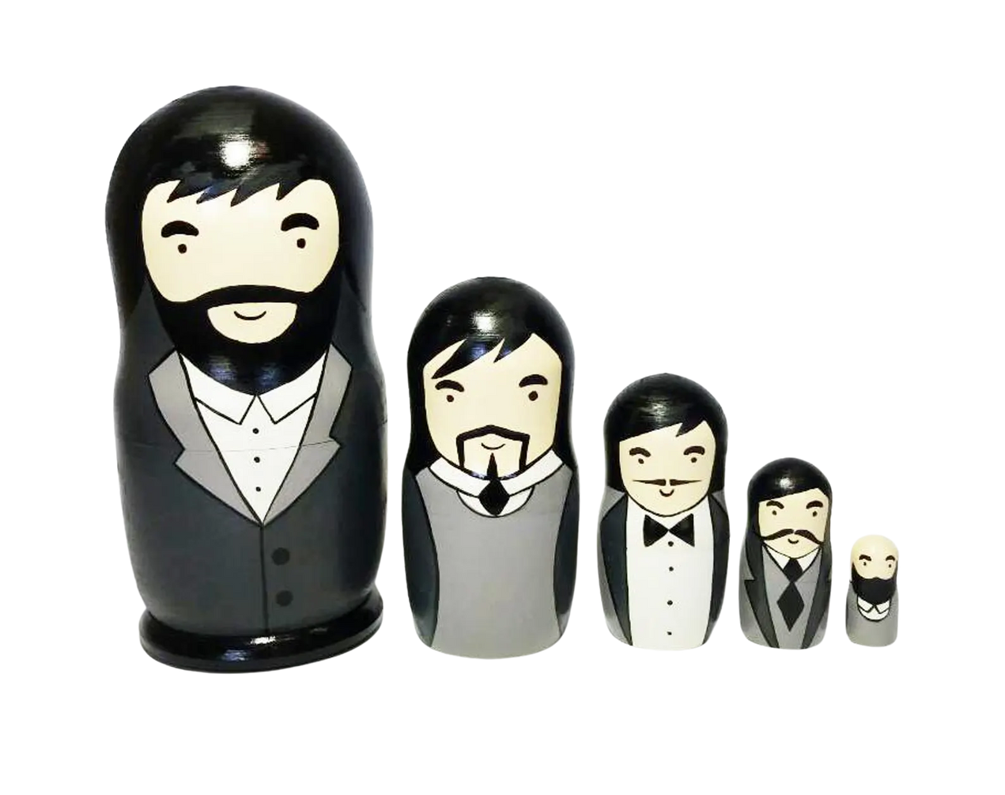
Trauma
  1980s “Developmental Model of Maturity”, therapist Pia Mellody
  1990s “Relational Life Therapy”, therapist Terry Real
  Three parts of self:
Wounded Child
Adaptive Adolescent
Wise Man

Slide 40
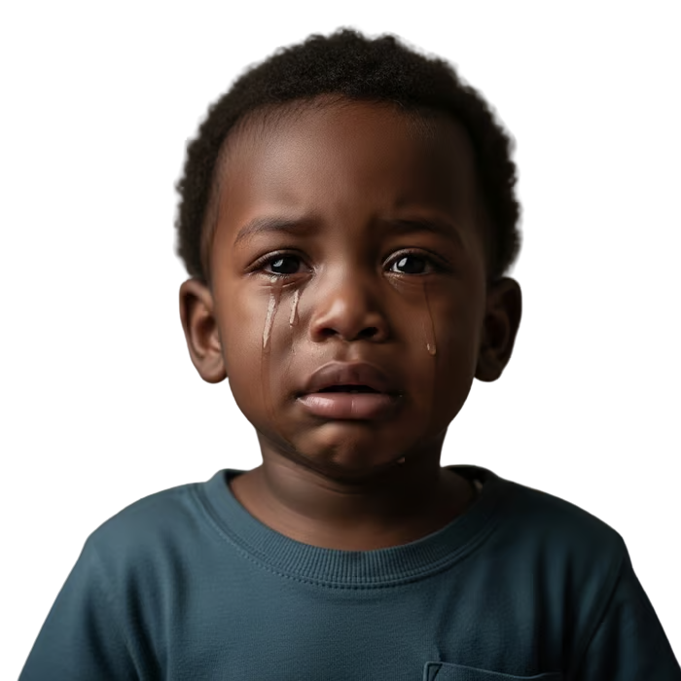
Wounded Child
  Carries unaddressed core wounds from family of origin and/or early childhood.
  Chronic rejection, abandonment, criticism, abuse or neglect, lead to feelings of hurt, shame, fear, or helplessness that continue to sabotage our emotional and spiritual maturity in adulthood.
  This is our post-fall reality after the trauma sin infected all living beings.

Slide 41
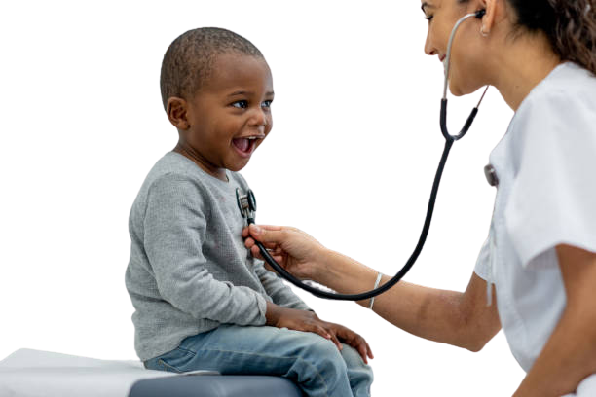
Wounded Child
  Our wounded parts need to be seen, acknowledged, attended to progress to the emotional and spiritual maturity God designed us for.
  We can’t change the facts of our story, but by God’s grace we can change the meaning that our story holds and look back with deeper compassion and hope.

Slide 42

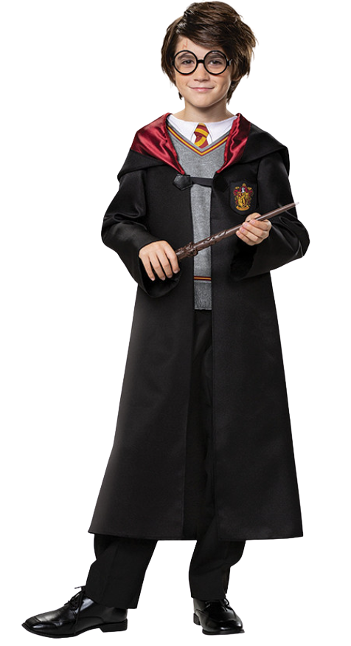
Adaptive Child
  This is our defensive, reactive self that protects us from pain.
  Does whatever he needs to do to survive the effects of the trauma that the wounded child suffered.
  You can identify it when you feel stressed or triggered and operate from a place of emotional reactivity and dysregulation.

Slide 43
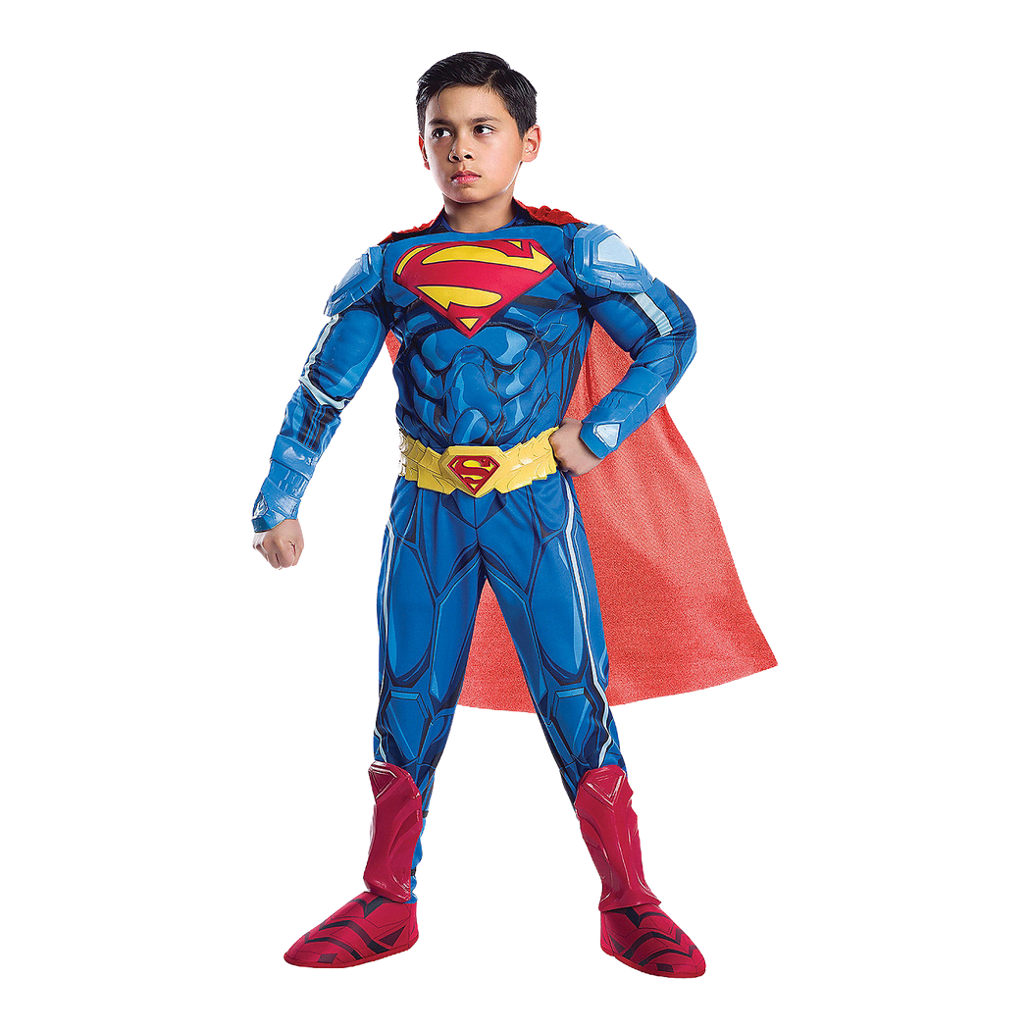
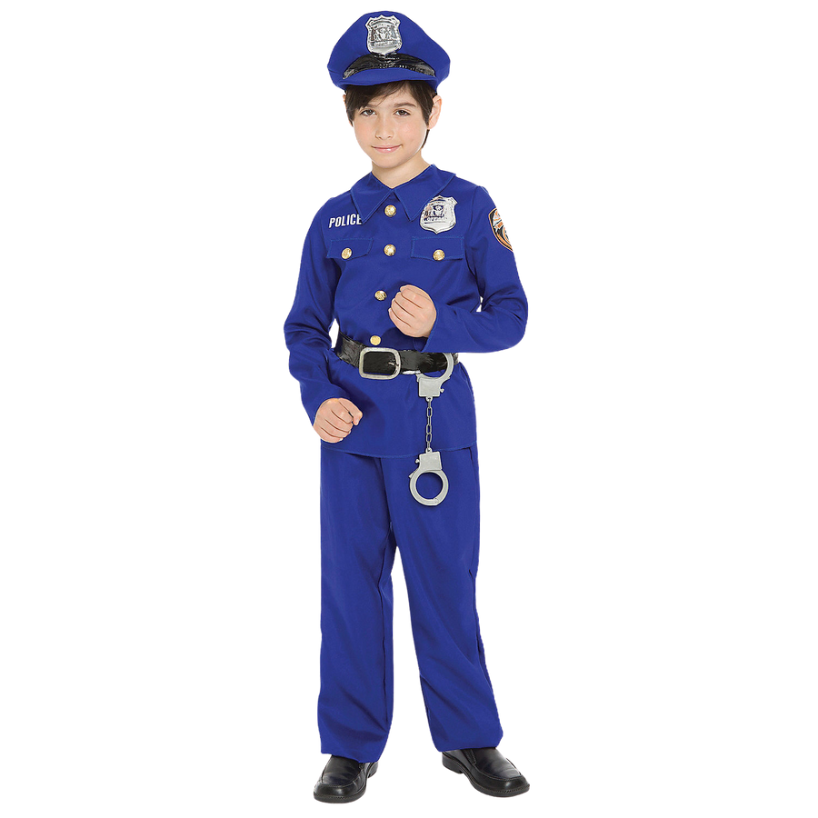
Adaptive Child
  Adaptive behaviors can look like career success, athletic prowess, or reading our Bible often.
  Maladaptive attempts to medicate our pain can include porn use, abuse, along with other self-medicating substances and activities.
  It could harm and keep you isolated, alone, unable to create and sustain healthy relationships with God and others.

Slide 44

Wise Adult
  The mature part of yourself associated with good judgement, planning, prioritizing, and decision making based on awareness of long-term consequences.
  This part of us can respond to the present moment with clarity, compassion, and choice.
  Living life through our wise adult is the goal of our healed masculine journey.

Slide 45

Wise Adult
  Has a clear identity in Christ. He knows who he is and why he is. He has integrated his shadow and glory.
  Has learned to recycle his pain into his Kingdom-building purpose.
  Knows the terrain of his inner world and can ask for what he needs or takes a time-out when he feels like he has relapsed into his wounded and/or adaptive child.

Slide 46
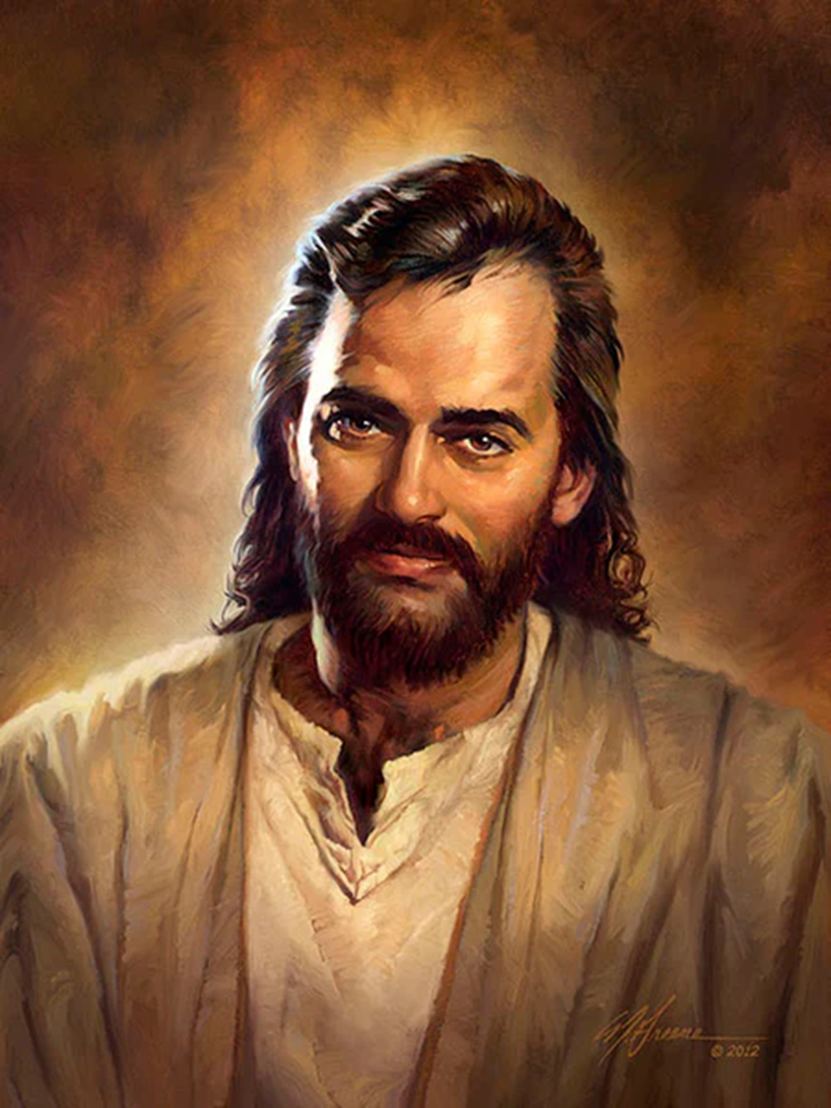
Jesus: Best Example of Healthy, Biblical Masculinity
  Defended the weak and confronted injustice
  Highlighted humility and servanthood
  Displayed strength through self-control and sacrificial love
  Expressed emotions in a healthy way

Slide 47
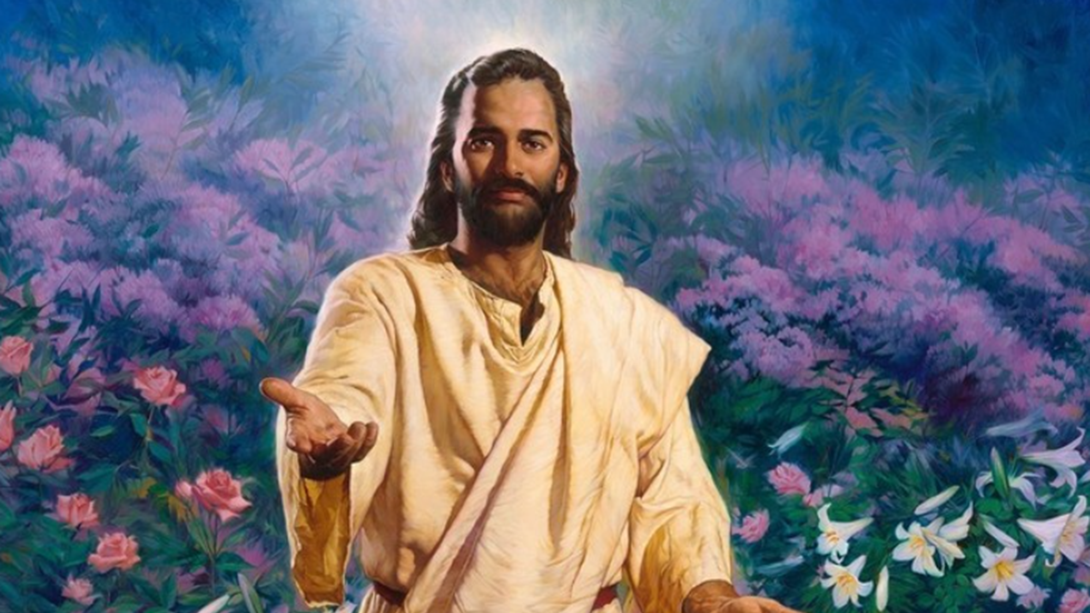
Jesus: Best Example of Healthy, Biblical Masculinity
  Befriended and mentored other men through healthy relationships
  Modeled how to resist temptation

Slide 48


Slide 49
